Slide 1
World Population Analysis & Prediction
Data Science & Machine Learning Project
By - Shruti Gupta

Slide 2
Introduction
World population Dataset contains Historical Population data for every Country/Territory in the world by different parameters like Area Size of the Country/Territory, Name of the Continent, Name of the Capital, Density, Population Growth Rate, Ranking based on Population, World Population Percentage.

Slide 3
Objective
To analyze the population trends in various countries and world as a whole over the years.
To visualize the same with graphs
To analyze the UN population dataset and join with the given dataset to find insights
To predict population and correlation between features using Linear Regression

Slide 4
Tools & Frameworks Used
Python for EDA
Matplotlib and Seaborn libraries for visualization
Plotly for maps
LinearRegression OLS model for predictions

Slide 5
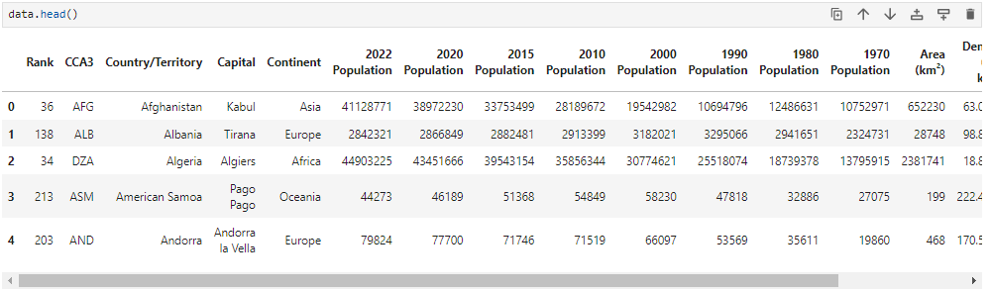
Dataset 1– world_population.csv
First 5 rows of the dataset

Slide 6
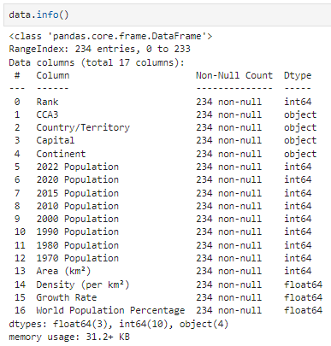
The dataset consists of entries for population of countries, their rank based on population and other information about them
Analysis will be done based on these columns to find trends and insights

Slide 7
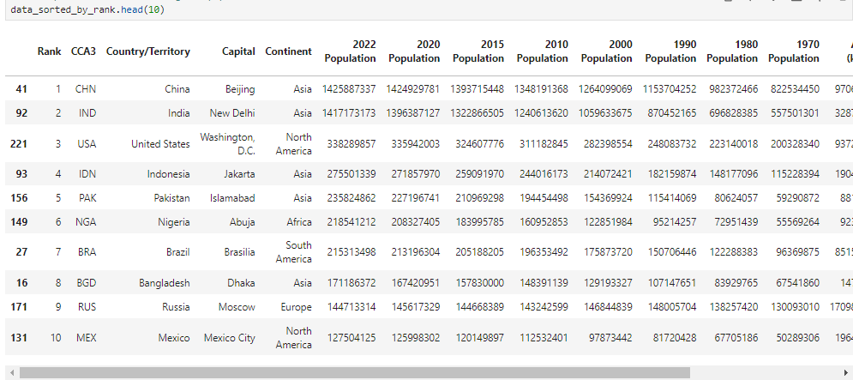
EDA
Top 10 countries with highest population

Slide 8
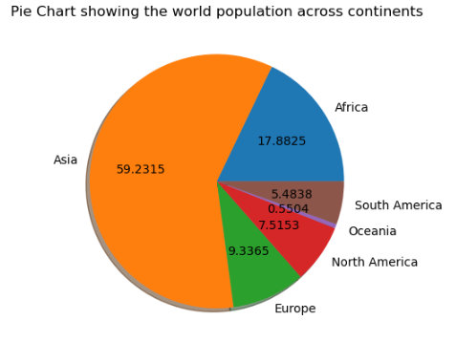
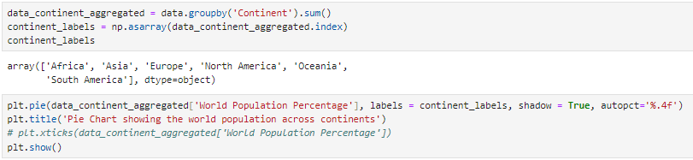
Data Visualization
World population across continents
INFERENCE
Maximum populated continent is Asia with 59% followed by Africa at 17%.

Slide 9
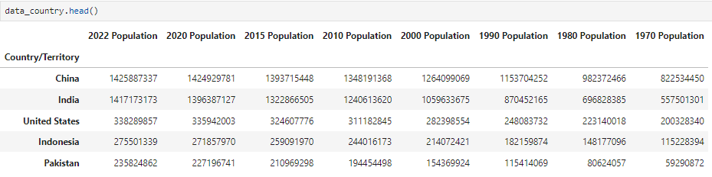
EDA
Analyzing population country-wise over the years
Create a new dataset
Update index and sort values by ‘2022 population’ in descending order

Slide 10
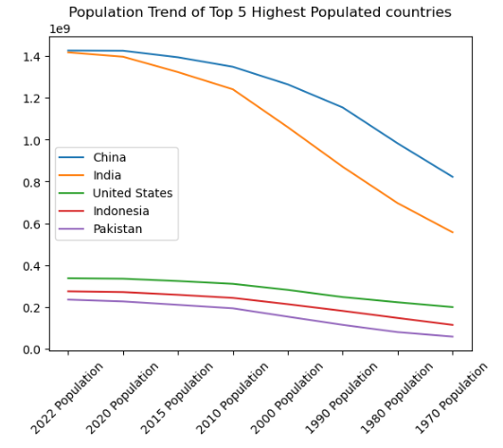
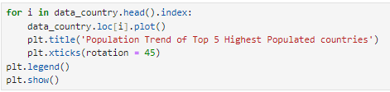
Data Visualization
INFERENCE
A steep increase in population is seen for China and India from 1970 to 2010
Population trend of top 5 highest populated countries over the years

Slide 11
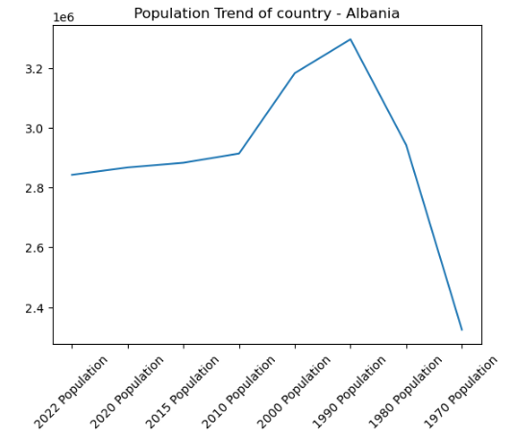
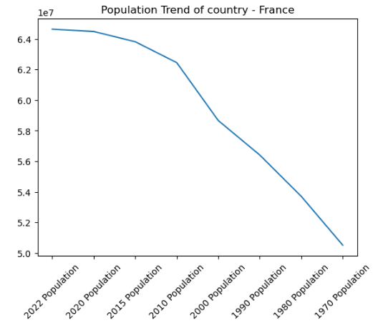
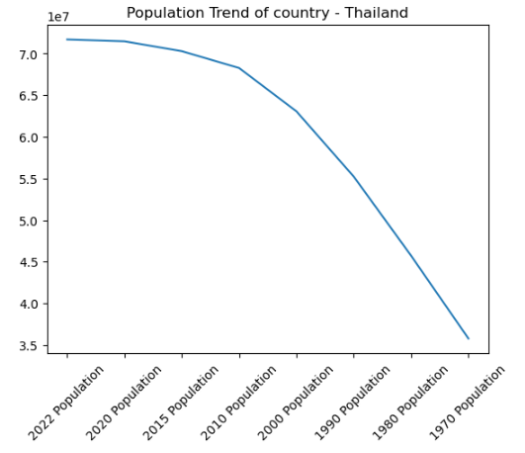
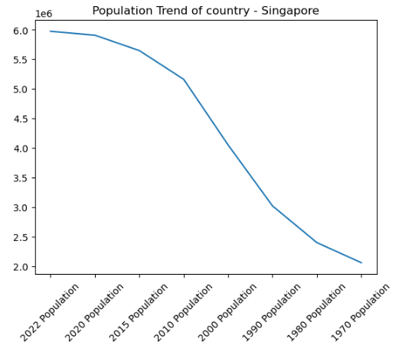
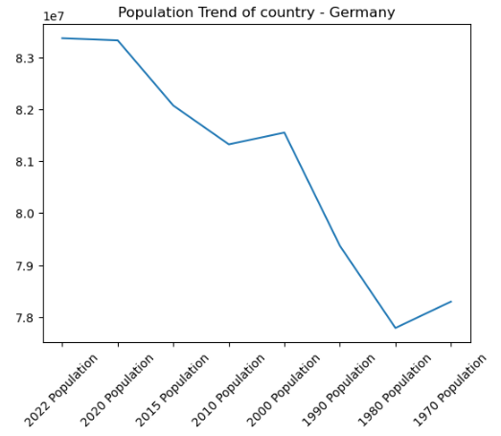
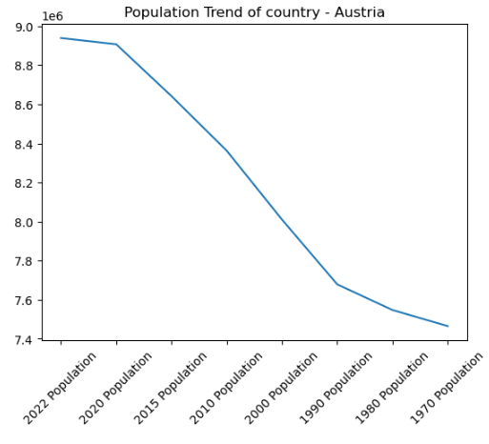
Data Visualization - Population trend of some countries

Slide 12
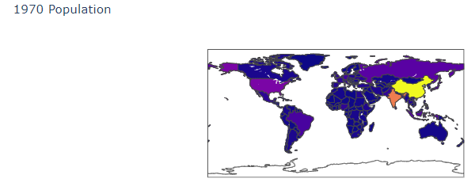
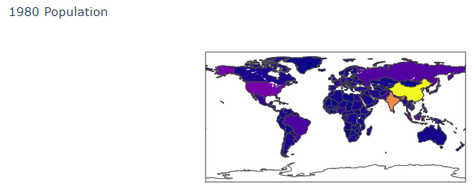
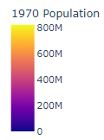
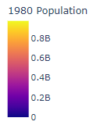
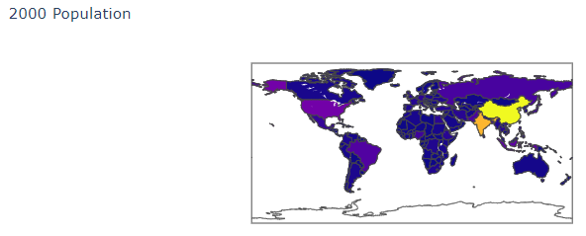

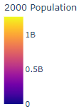
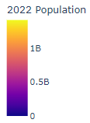
Data Visualization
World Population growth for the years 1970, 1980, 2000 and 2022
INFERENCE
We can see INDIA turning from orange to yellow by 2022, Asia being in yellow zone (highest populated) always

Slide 13
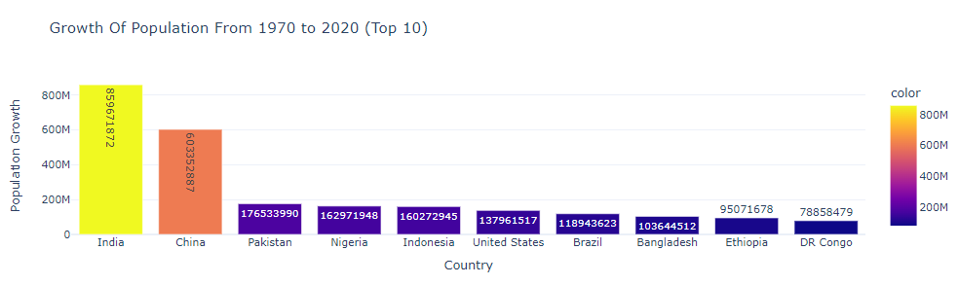
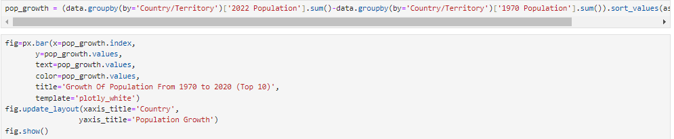
Data Visualization
Maximum Population Growth of top 10 countries

Slide 14
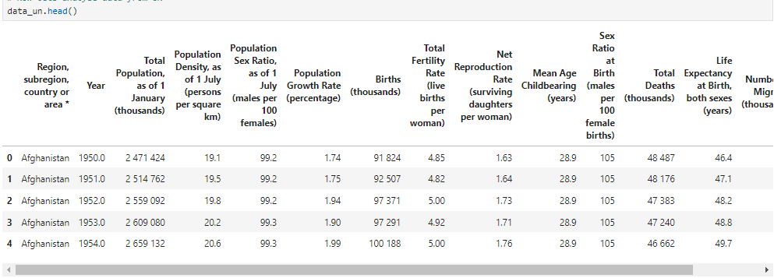
Dataset 2– world_data_UN.csv
First 5 rows of the dataset

Slide 15
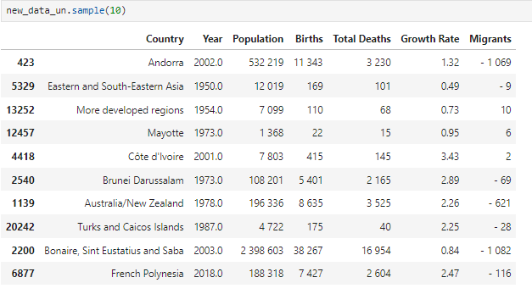
EDA – Cleanup & Preprocessing
Rename and drop unwanted columns to get the desired dataframe

Slide 16
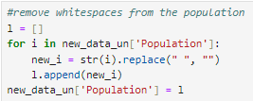
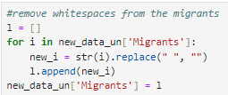
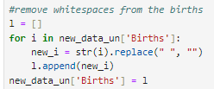
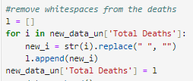
EDA – Cleanup & Preprocessing
The UN dataframe contains whitespaces for Population, Total deaths, Births and Migrants, these should be removed for data analysis

Slide 17
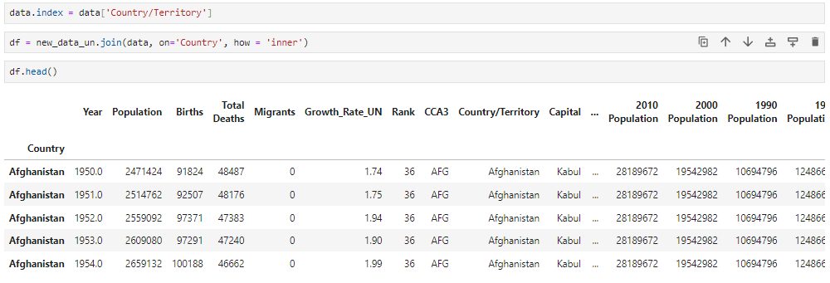
EDA – Integrating data frames

Slide 18

EDA – Cleanup & Preprocessing
Drop unwanted columns
Cleanup data by replacing illegal characters
Drop null values
Change the datatype to numeric

Slide 19
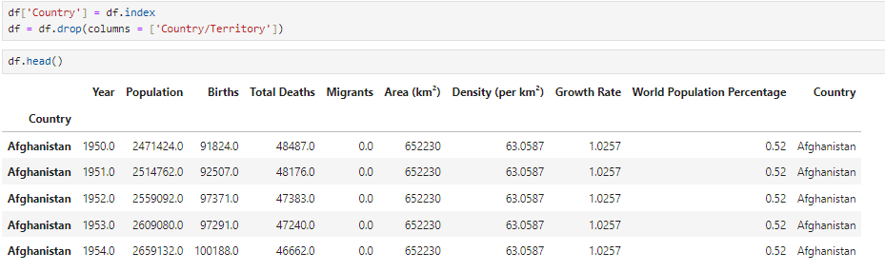
Integrated Data frame df

Slide 20
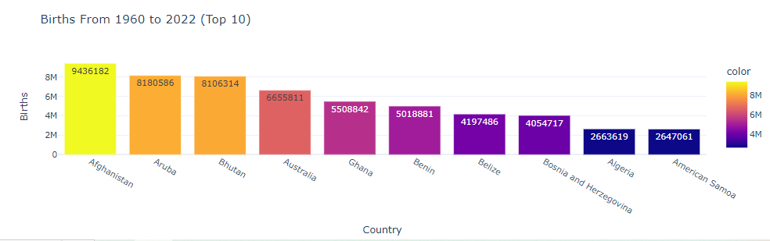
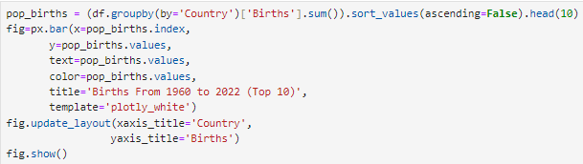
Data Visualization
Births from 1960 to 2022

Slide 21
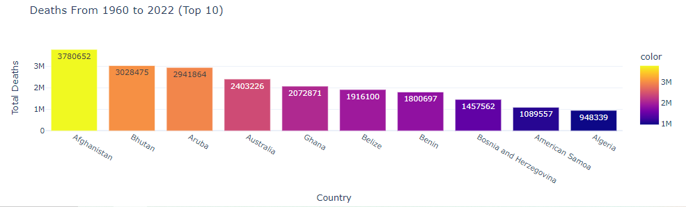
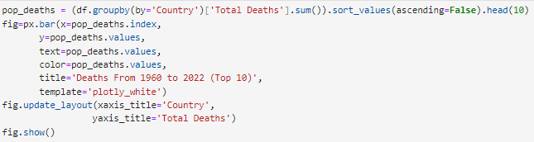
Data Visualization
Deaths from 1960 to 2022

Slide 22
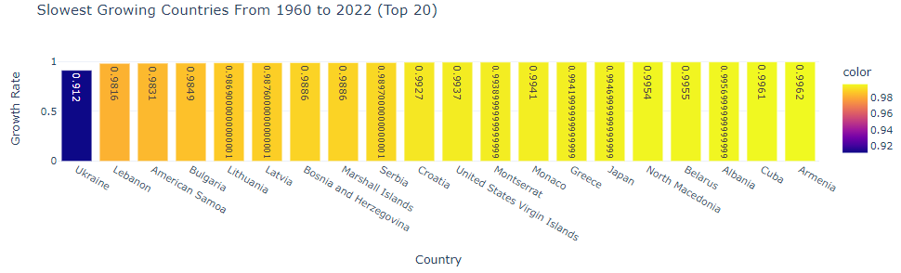
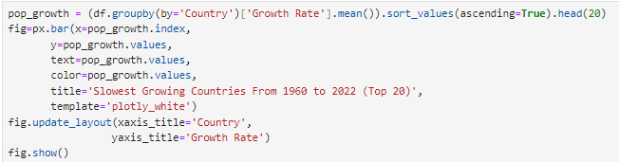
Data Visualization
Slowest Growing Countries based on growth rate

Slide 23
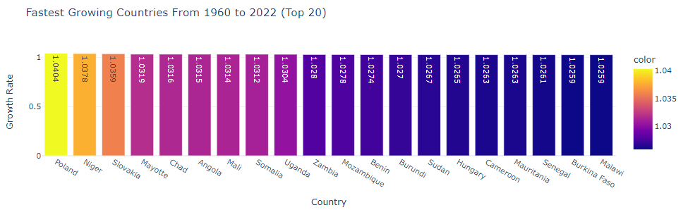
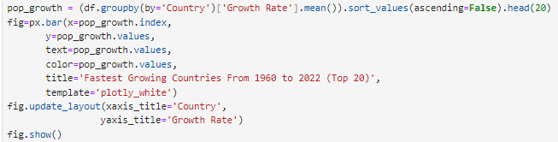
Data Visualization
Fastest Growing Countries based on growth rate

Slide 24
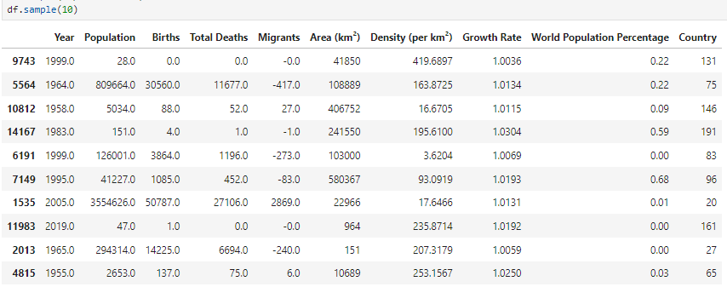

Linear Regression - Machine Learning
Encode ‘Country’ column into numeric
Set X and Y

Slide 25
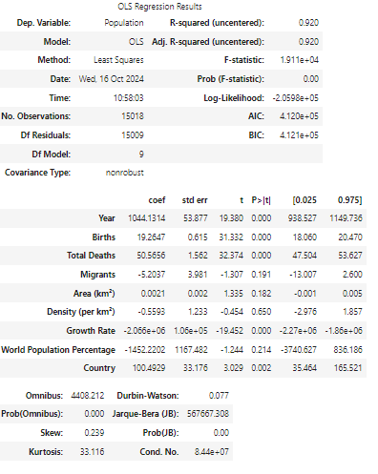

Linear Regression - Machine Learning
3. Apply OLS model
INFERENCE
R squared value is 92%, means that 92% is the probability that population can be predicted from the features.

Slide 26
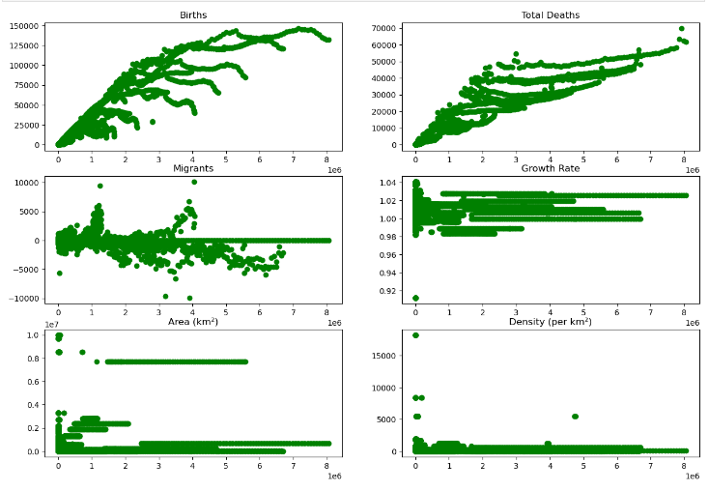
Population correlation with other features – scatter plots

Slide 27
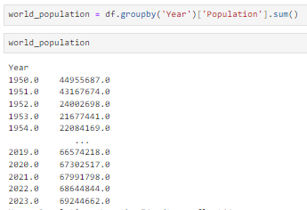

Predictions- Machine Learning
Predicting population based on Years
Set X and Y

Slide 28


Linear Regression - Machine Learning
3. Apply Linear Regression
4. Create a Prediction array for years
5. Predict with the trained model

Slide 29
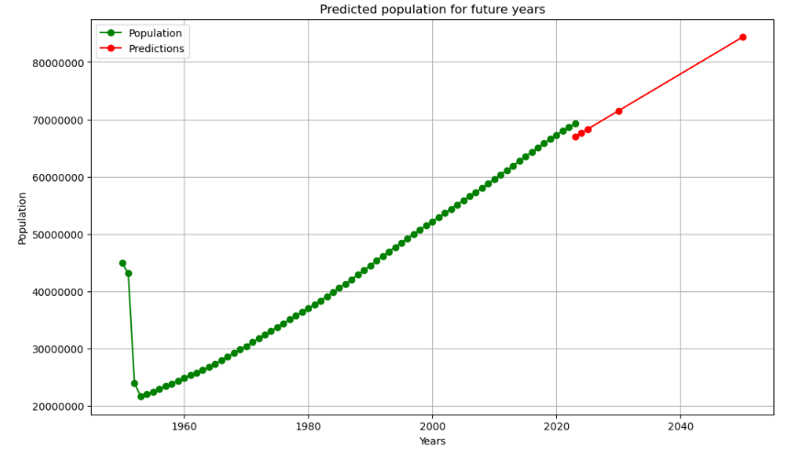
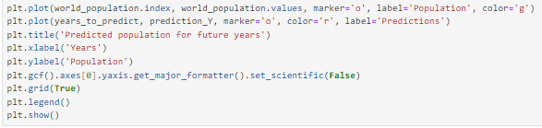
Plot the graph showing the given data and predicted population

Slide 30
Thank You!
Shruti Gupta

